Slide 1
Operator Overloading (CS 217)
Mr. Jawad Hassan,
Department of Computer Science,
National University of Computer & Emerging Sciences, Islamabad Campus

Slide 2
Review of Last Lecture

Slide 3
Operator Overloading Motivation
Conclusively, Operator overloading:
Enabling C++’s operators to work with class objects
Using traditional operators with user-defined objects
Requires great care; when overloading is misused, program difficult to understand
Don’t want to create new operators for user-defined data types

Slide 4
How to Overload an Operator?
An operator can be overloaded by declaring a special member function in the class
Name of the member function is operator that is followed by operator symbol e.g., operator+, operator/, etc.
Can be independent function (except for the following operators: ( ), [ ], -> or any of the assignment operators)
Can be a class’s member function (must be non-static)
Notes:
Can be a member function (must be non-static): to be able to work on objects of the class
If you plan on implementing ->, () or [] they are naturally member methods.
The binary operators = (assignment), [] (array subscription), -> (member access), as well as the n-ary () (function call) operator, must always be implemented as member functions, because the syntax of the language requires them to.

Slide 5
How to Overload an Operator?
Member function: If the left operand of that particular class is an object of the same class, then the overloaded operator is said to be implemented by a member function.
Non-member function: If the left operand of that particular class is an object of a different class, then the overloaded operator is said to be implemented by a non-member function
Notes:
Can be a member function (must be non-static): to be able to work on objects of the class
If you plan on implementing ->, () or [] they are naturally member methods.
A unary operator @, applied to an object x, is invoked either as operator@(x) [non member implementation] or as x.operator@() [member implementation]. A binary infix operator @, applied to the objects x and y, is called either as operator@(x,y) [non-member implementation] or as x.operator@(y) [member implementation]

Slide 6
Overload as Member or Non-Member Function
If it is a unary operator, implement it as a member function.
If a binary operator treats both operands equally (it leaves them unchanged), implement this operator as a non-member function.
If a binary operator does not treat both of its operands equally (usually it will change its left operand), it might be useful to make it a member function of its left operand’s type
Notes:
Can be a member function (must be non-static): to be able to work on objects of the class
If you plan on implementing ->, () or [] they are naturally member methods.
A unary operator @, applied to an object x, is invoked either as operator@(x) [non member implementation] or as x.operator@() [member implementation]. A binary infix operator @, applied to the objects x and y, is called either as operator@(x,y) [non-member implementation] or as x.operator@(y) [member implementation]

Slide 7
Syntax to Overload an Operator
returnType operator opsymbol(parameters){ }
↑ ↑ ↑ ↑ any type keyword operator symbol function body
return-type may be whatever the operator returns
Operator symbol may be any overloadable operator
Example:
void operator+ (parameters){ }
↑ ↑ ↑ ↑ any type keyword operator symbol function body

Slide 8
Operator Overloading
Operators are really functions
They have arguments, they return values
The only difference is that their names take on a specific form:
Operator+, operator[ ]
Overloading provides concise notation:
// without operator overloading object2 = object1.add(object2);
// with operator overloading
object2 = object2 + object1;

Slide 9
Restriction on Operator Overloading
With operator overloading we cannot change:
How operators act on built-in data types:
i.e., cannot change integer addition
Precedence of operator (order of evaluation)
Use parentheses to force order-of-operations
Association rules (left-to-right or right-to-left evaluation)
Number of operands
i.e., & is unary, only acts on one operand
Cannot create new operators
Operators must be overloaded explicitly:
i.e., Overloading + , does not overload +=
Notes:
at least one of the operands has to be of a user-defined type.

Slide 10
Restriction on Operator Overloading
http://www.stroustrup.com/bs_faq2.html#overload-dot
Notes:
The comma operator (represented by the token, ) is a binary operator that evaluates its first operand and discards the result, it then evaluates the second operand and returns this value (and type). The comma operator has the lowest precedence of any C operator, and acts as a sequence point.
->* is an operator to operate on function pointers
https://isocpp.org/wiki/faq/operator-overloading#overload-dot
http://www.stroustrup.com/bs_faq2.html#overload-dot
There is no fundamental reason to disallow overloading of ?:. I just didn't see the need to introduce the special case of overloading a ternary operator. Note that a function overloading expr1?expr2:expr3 would not be able to guarantee that only one of expr2 and expr3 was executed.
Sizeof cannot be overloaded because built-in operations, such as incrementing a pointer into an array implicitly depends on it. Consider:
Operator . (dot) could in principle be overloaded using the same technique as used for ->. However, doing so can lead to questions about whether an operation is meant for the object overloading . or an object referred to by . For example:

Slide 11
Operator =, operator &
Operator = and operator & are overloaded implicitly for every class, so they can be used for each class objects.
operator = performs member-wise copy of the data members.
operator & returns the address of the object in memory.

Slide 12
Invoking Objects
If the operator is binary but there is only one explicit argument, the ‘invoking instance’ is assumed to be the one on the left hand side of the expression.
class Date
{
public: // member functions
Date operator=(Date& d);
};
int main (void)
{
s1 = s2; // instead of s1.operator=(s2);
}

Slide 13
Assignment Operator (=)
class Employee
{ private:
int idNum;
double salary;
public:
Employee ( ) { idNum = 0, salary = 0.0; }
void setValues (int a, int b);
void operator= (double );
}
void Employee::setValues ( int idN , double sal )
{
salary = sal; idNum = idN;
}
void Employee::operator = (double sal)
{ salary = sal; }

Slide 14
Assignment Operator (=)
int main ( )
{
Employee emp1;
emp1.setValues(10,33.5);
Employee emp2;
emp2 = 44.6; // emp2 is calling object
}

Slide 15
Assignment Operator (=)
class Employee
{ private:
int idNum;
double salary;
public:
Employee ( ) { idNum = 0, salary = 0.0; }
void setValues (int a, int b);
void operator= (Employee &emp );
}
void Employee::setValues ( int idN , double sal )
{ salary = sal; idNum = idN; }
void Employee::operator = (Employee &emp)
{ salary = emp.salary; }

Slide 16
Assignment Operator (=)
int main ( )
{
Employee emp1;
emp1.setValues(10,33.5);
Employee emp2;
emp2 = emp1; // emp2 is calling object
}

Slide 17
Overloading Relational operators

Slide 18
Employee class and objects
class Employee
{
private:
int idNum;
double salary;
public:
Employee(int id, double salary);
double addTwo (Employee& emp);
double operator+ (Employee& emp);
double getSalary() { return salary; }
};

Slide 19
Overloading > operator
bool Employee::operator>(Employee& e)
{
return(salary > e.salary);
}
called from the program like this:
if (emp1 > emp2)
emp1 > emp2 // emp1.operator(emp2);

Slide 20
Operator Overloading Syntax
Although, the syntax of defining prototype:
datatype operator+ (datatype)
However, for some operators, there is little bit change in the above syntax:
++, -- operators
>>, << operators
& and [ ] operators

Slide 21
Comparison Operator (==)
class Employee
{ private:
int idNum;
double salary;
public:
Employee ( ) { idNum = 0, salary = 0.0; }
void setValues (int a, int b);
bool operator== (Employee &emp );
}
void Employee::setValues ( int idN , double sal )
{ salary = sal; idNum = idN; }
bool Employee::operator == (Employee &emp)
{ return (salary == emp.salary); }

Slide 22
Comparison Operator (==)
int main ( )
{
Employee emp1;
emp1.setValues(10,33.5);
Employee emp2;
emp2.setValues(10,33.1);
if ( emp2 == emp1 )
cout <<“Both objects have equal value”;
else
cout <<“objects do not have equal value”;
}

Slide 23
Overloading ++ and --
Operator ++ and -- are different to other operators of C++
We can call them:
either in the form of prefix (++i) before an object
or in the form of postfix (i++) after an object
But in both cases, the calling object will be i.

Slide 24
Int a =11;
Int b=4;
// ++a = a++ => a = a+1 a = 11
//cout<<a++;//10
cout<<10 * 4;//40

Slide 25
i++ and ++i ?
Prefix makes the change, and then it processes the variable
Postfix processes the variable, then it makes the change.
i = 1;
j = ++i;
(i is 2, j is 2)
i = 1;
j = i++;
(i is 2, j is 1)

Slide 26
Overloaded ++
class Inventory
{
private:
int stockNum;
int numSold;
public:
Inventory(int stknum, int sold);
void operator++();
};
void Inventory::operator++()
{
numSold++;
}

Slide 27
Use of the operator ++
int main ( )
{
Inventory someItem(789, 84);
// the stockNum is 789
// the numSold is 84
++someItem;//someItem.operator();
someItem++;//someItem.operator(int);
Inventory Item2 = ++someItem;
//will this instruction work
}
Notes:
Inventory Item 2 = ++someItem; // Will not work as the overloaded function does not return anything

Slide 28
Overloaded ++
class Inventory
{
private:
int stockNum;
int numSold;
public:
Inventory(int stknum, int sold);
Inventory& operator++();
};
Inventory& Inventory::operator++()
{
Inventory *object = new Inventory(0,0);
numSold++;
object->numSold = numSold;
return(*object);
}

Slide 29
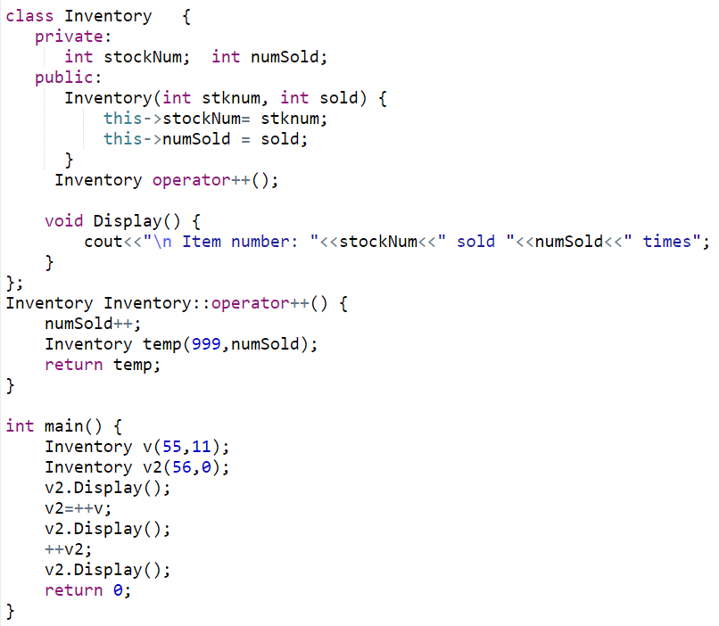
Using ++ (Prefix Notation)
Notes:
Item number: 56 sold 0 times
Item number: 999 sold 12 times
Item number: 999 sold 13 times

Slide 30
Problem
The definition of the prefix operator is easy enough. It increments the value before any other operation.
But, How will C++ be able to tell the difference between a prefix ++ operator and a postfix ++ operator?
Answer: overloaded postfix operators take a dummy argument (just for differentiation between postfix and prefix).

Slide 31
Postfix operator
Inventory& Inventory::operator++() // prefix version
{
Inventory *object = new Inventory(0,0);
numSold++;
object->numSold = numSold;
return(*object);
}
Inventory& Inventory::operator++(int) // postfix version
{
Inventory *object = new Inventory(0,0);
object->numSold = numSold;
numSold++;
return(*object);
}
dummy argument

Slide 32
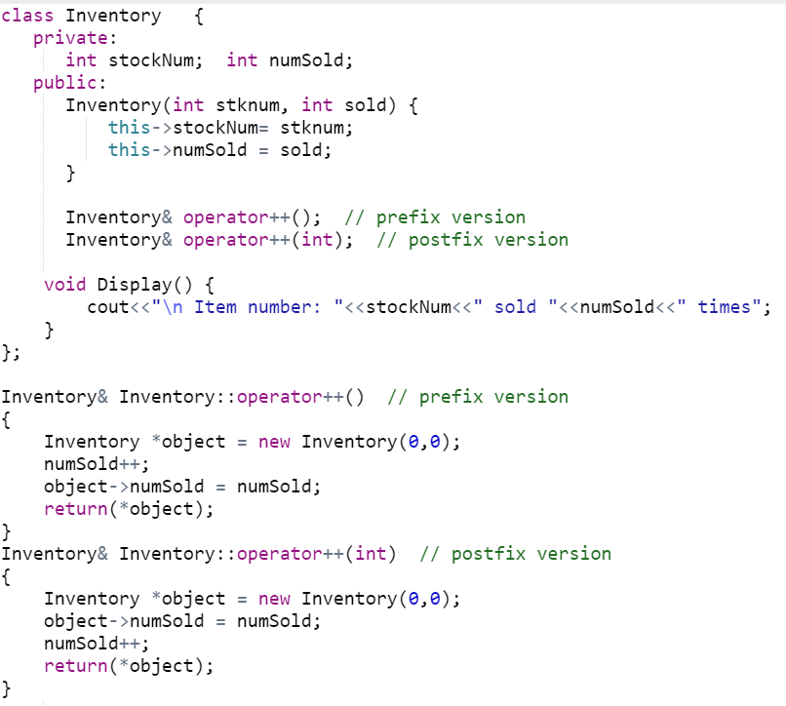
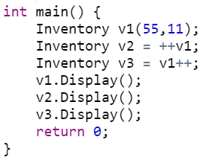
Postfix and Prefix ++
Notes:
Item number: 1 sold 13 times
Item number: 2 sold 12 times
Item number: 3 sold 12 times

Slide 33
Subscript operator [ ]
With the help of [ ] operator, we can define array style syntax for accessing or assigning individual elements of classes
Student semesterGPA;
semesterGPA[0] = 3.5;
semesterGPA[1] = 3.3;

Slide 34
Subscript operator[ ]
class Student
{ private:
double gpa[8];
public:
Student ()
{ gpa[0]=3.5; gpa[1]=3.2; gpa[2]=4; gpa[3]=3.3;
gpa[4]=3.8; gpa[5]=3.6; gpa[6]=3.5; gpa[7]=3.8;
}
double& opeator[] (int Index);
}
double& Student::operator [ ] (int Index)
{
return gpa[Index];
}

Slide 35
Subscript operator[ ]
int main ( )
{
Student semesterGPA;
semesterGPA[0] = 3.7;// semesterGPA.operator[](0) = 3.7;
double gpa = semesterGPA[4];//semesterGPA.operator[](4);
}

Slide 36
Subscript operator[ ]
How the statement executes?
semesterGPA[0]=3.7;
The [ ] has highest priority than the assignment operator, therefore semesterGPA[0] is processed first.
semesterGPA[0] calls operator [ ], which then return a reference of semesterGPA.gpa[0].

Slide 37
Subscript operator[ ]
The return value is reference to semesterGPA.gpa[0], and the statement semesterGPA[0] = 3.7 is actually integer assignment.
int main ( )
{
Student semesterGPA;
semesterGPA[0] = 3.7;
// the above statement is processed like as
semesterGPA.gpa[0] = 3.7
}

Slide 38
Todays Lecture
Relational operators
Increment (a++, ++a)
Subscript []

